Slide 1
IAIA Final Project
ShoeBot : automated shoes organizing system
2023.06.14
Prof. Young-keun Kim
21700435 Tae-Gyun Yang
21800773 Min-Woong Han
21901057 Jun-Young Choi

Slide 2
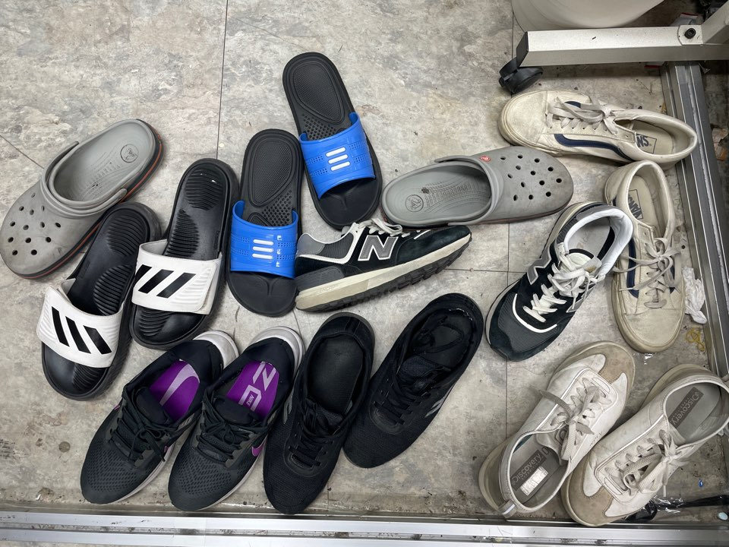
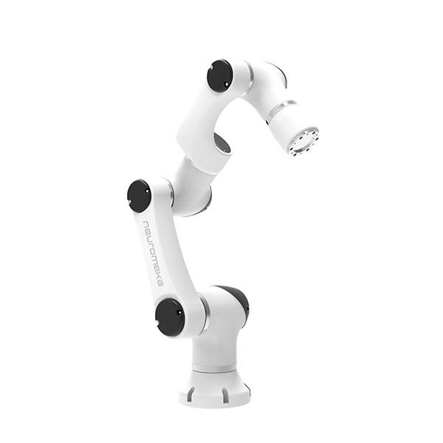
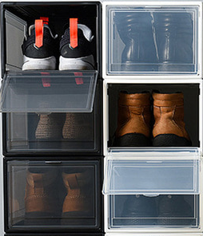

▣ Problem definition
Background and proposal
user
[ source : A shoe rack in a lap ]
Implementation of automated shoes organizing
system based on robot arm

Slide 3
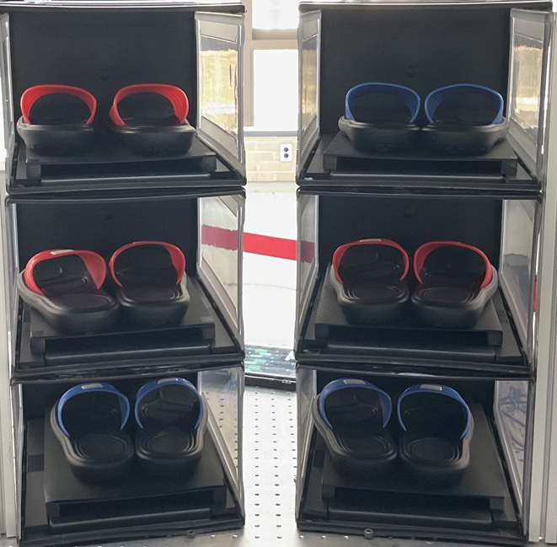
▣ System architecture
Hardware architecture
Specify index for each shoe rack
Configure the software to work with assigned indexes as well
To continuously update the presence or absence of shoes in
the shoebox corresponding to each index
0
3
1
4
2
5

Slide 4
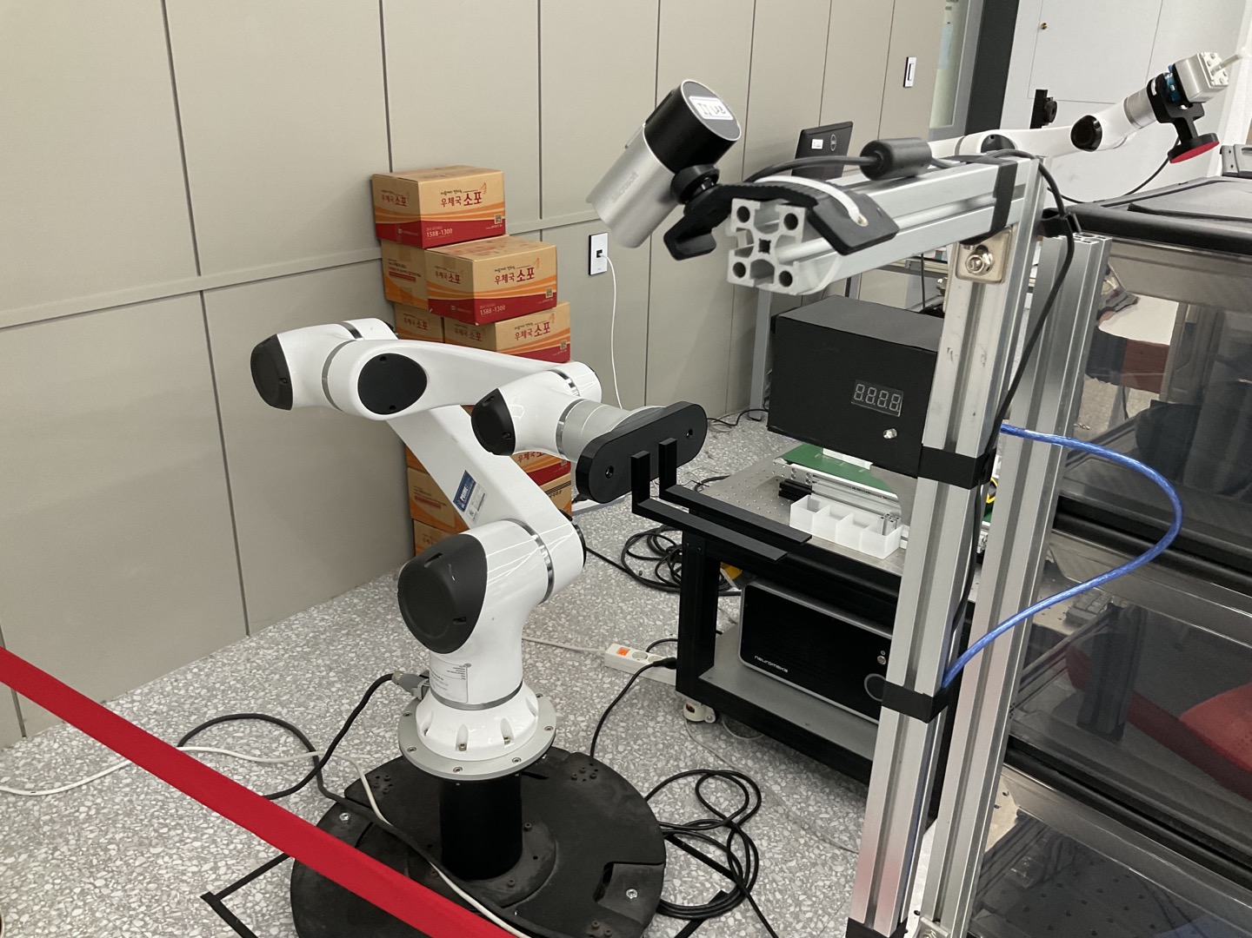
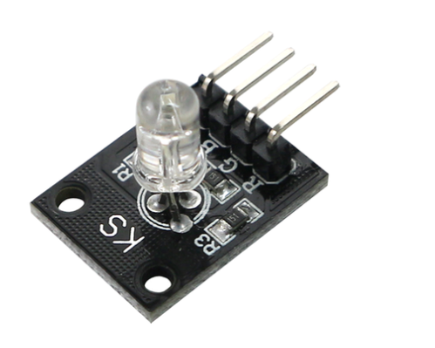
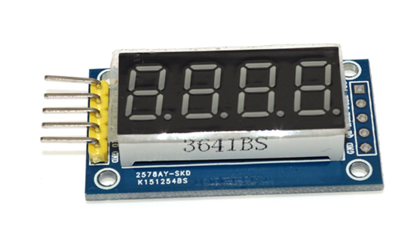
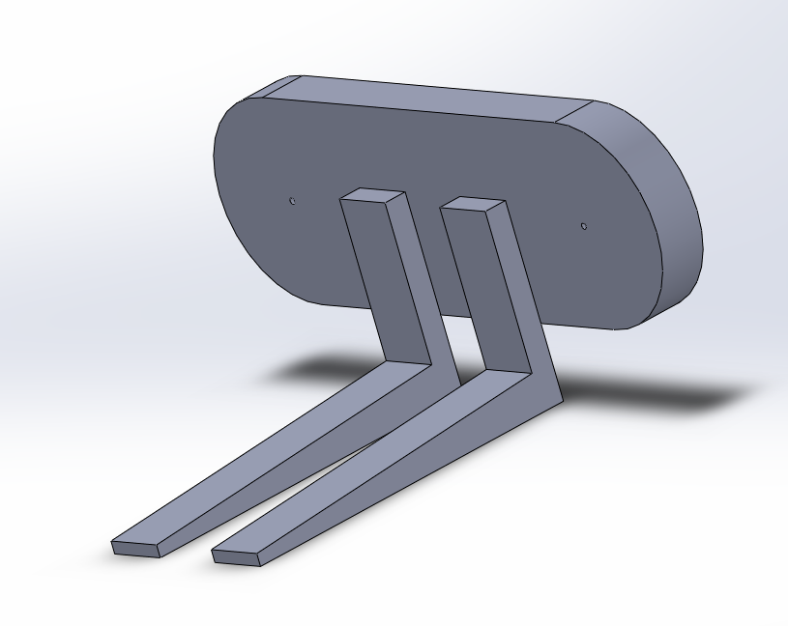
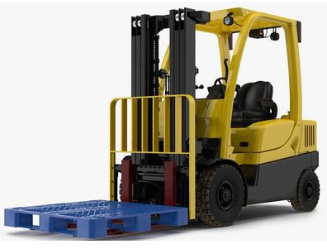
▣ System architecture
Hardware architecture
Microsoft life cam studio
- Utilized to determine user behavior
Visual display using arduino uno
4-bit digital tube module
RGB LED sensor
Manufacture of robot end effecter joint

Slide 5
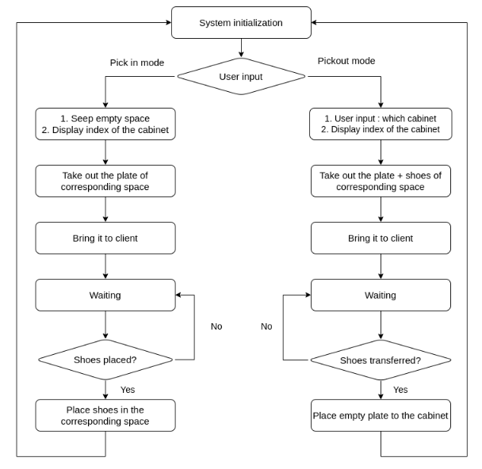
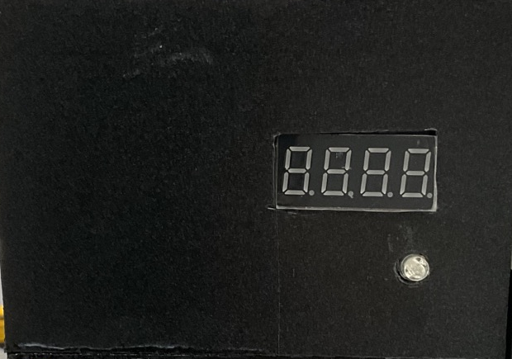
▣ System architecture
Flow chart
Microprocessor behavior during manipulation :
4 bit digital tube module
1) Pickin mode
- Display which cabinet is assigned
2) Pickout mode
- Display which cabinet is selected
RGB LED module
1) When robot is running : red light as danger alarm
2) When robot is stopped : blue light for safety alarm

Slide 6
▣ System architecture
Software architecture
Selected mode
Whether client done
Whether robot is running
Assigned cabinet index
Camera process
: object detection
Robot process
: main system
Arduino process
Whether robot done
Publisher – Subscriber ROS internal communication
USB port serial communication
Example : shoes pickin mode
Robot process
Camera process
Robot process
Check empty space
Pickout empty plate
Transfer plate to client
Receive workdone flag
If completed, detect shoes
is started
Receive & wait for a flag whether the user has finished putting the shoes
Put the shoes back in the cabinet when finished

Slide 7
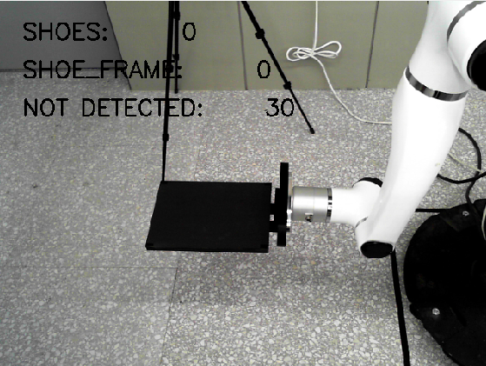
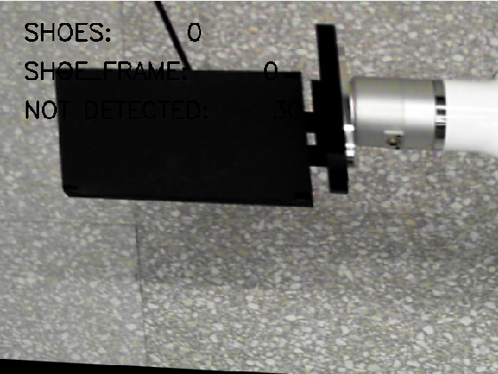
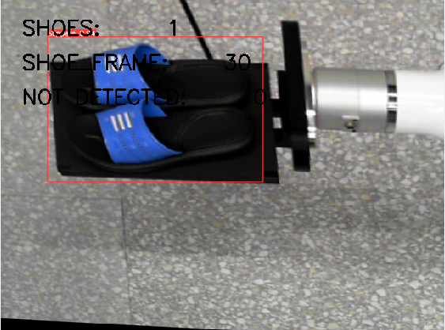
▣ Camera
Object detection
Object detection based on YOLO V5
Training data : 147 images of shoes
opencv inverse perspective mapping
: Change frame to top-down view
[ frame with inverse perspective mapping ]

Slide 8
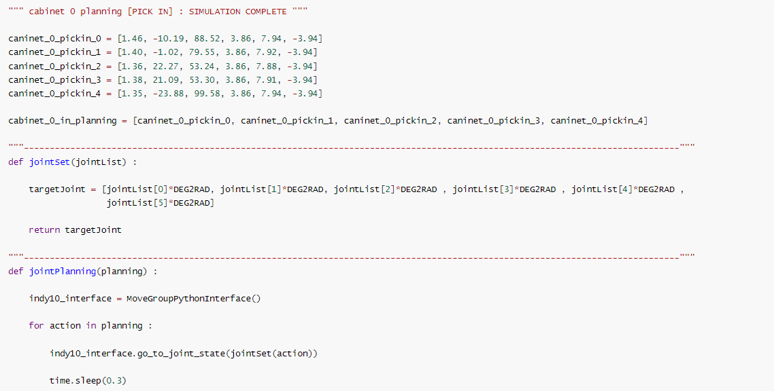
▣ Robot
Robot manipulation
Instability for path setting with absolute, relative coordinate → determined to use joint command
Organized system to save the joint commands required for each path planning and sequentially applied
Example)
Path planning
Unit conversion of degree value to radian for each joint command
Apply actual commands to the robot based on the converted value

Slide 9
▣ Robot manipulation
Original manipulation
Changed manipulation
Long time consumed for RVIZ update
Problem with the next command taking too long
Sequential command applying got faster
Slowing down problem as ROS running time increases still exists
Command to robot
Command to robot
Update RVIZ state with corresponding command
Self judgment of whether the command has completed
Compare current & RVIZ state
Apply next command if difference < tolerance
If judged to be complete, next command is applied

Slide 10
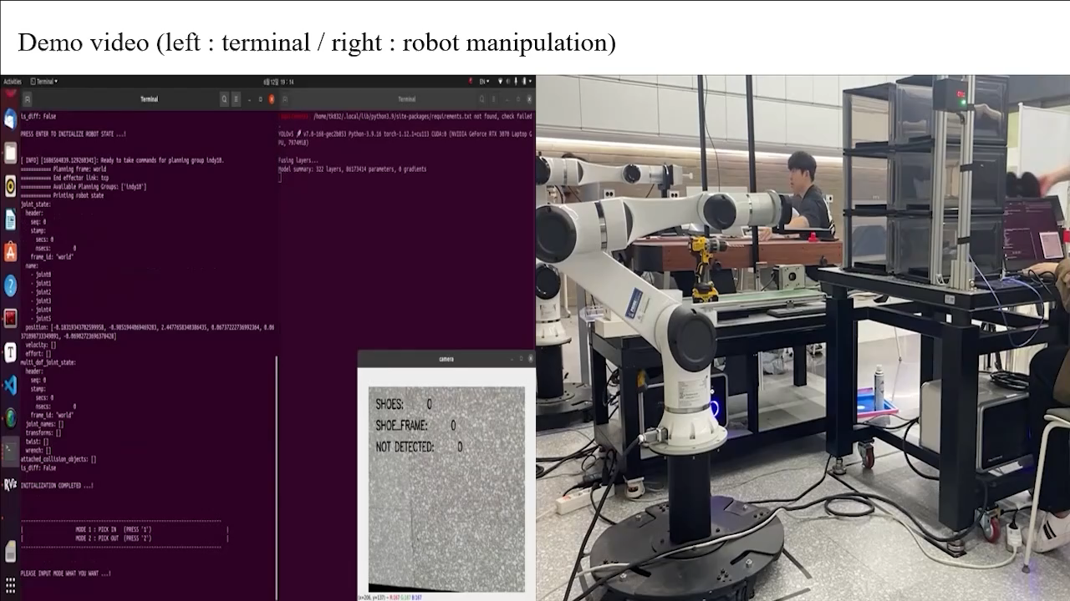
▣ Result (Demo video)
Pickin mode

Slide 11

▣ Result (Demo video)
Pickout mode

Slide 12
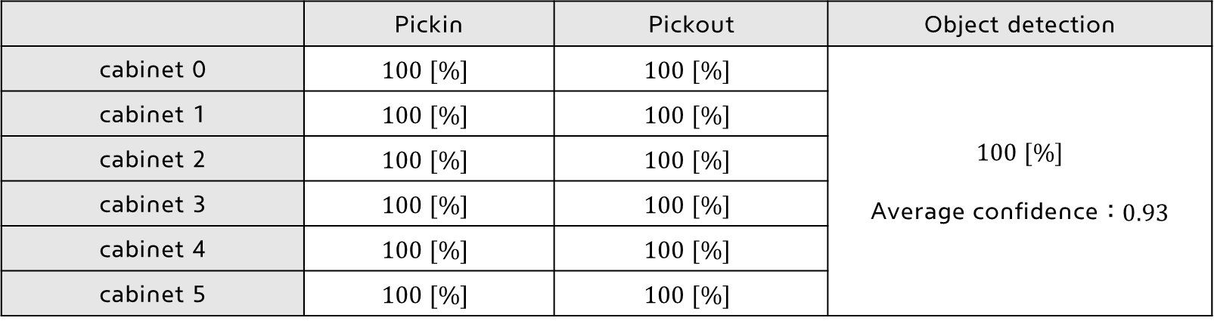
▣ Result
Performance evaluation
A total of 5 insertion and removal operations are performed for each compartment analysis is performed
Analysis of camera recognition accuracy
Evaluation index : success rate [%]
 | Pickin | Pickout | Object detection
cabinet 0 | $$100 [\%]$$ | $$100 [\%]$$ | $$100 [\%]$$ Average confidence : $0.93$
cabinet 1 | $$100 [\%]$$ | $$100 [\%]$$
cabinet 2 | $$100 [\%]$$ | $$100 [\%]$$
cabinet 3 | $$100 [\%]$$ | $$100 [\%]$$
cabinet 4 | $$100 [\%]$$ | $$100 [\%]$$
cabinet 5 | $$100 [\%]$$ | $$100 [\%]$$
High accuracy joint commands & High accuracy achieved by applying deep learning in static situations

Slide 13
Thank you

